Slide 1
Artificial Sweetener
SlideMake.com

Slide 2
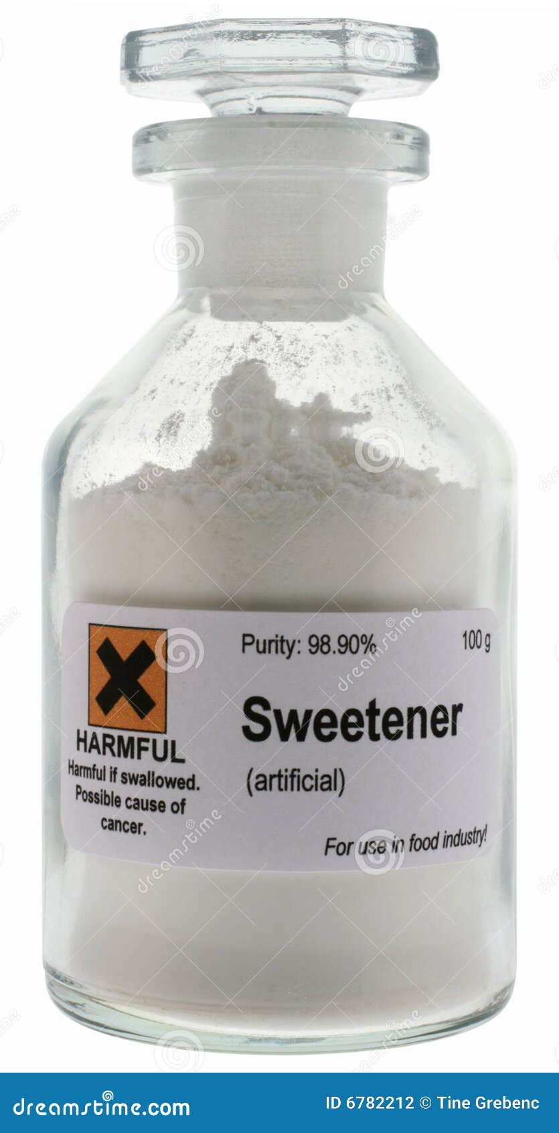
Introduction to Artificial Sweeteners
Artificial sweeteners are synthetic sugar substitutes that provide sweetness with little to no calories.
They are widely used in food and beverages to reduce sugar intake and manage weight.
Understanding their benefits and risks is essential for informed dietary choices.
1
Notes:
Image source: https://thumbs.dreamstime.com

Slide 3
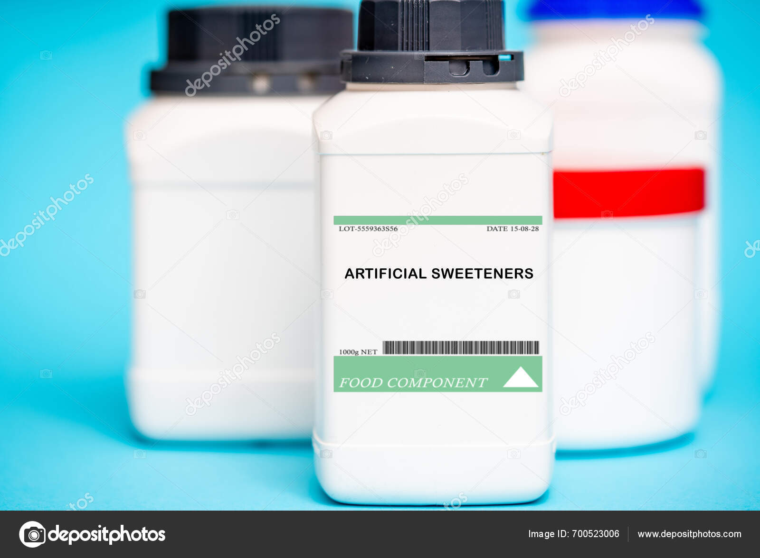
Types of Artificial Sweeteners
Common artificial sweeteners include aspartame, sucralose, and saccharin.
Each type has a different sweetness level and potential health effects.
Some are derived from natural substances, while others are entirely synthetic.
2
Notes:
Image source: https://st5.depositphotos.com

Slide 4
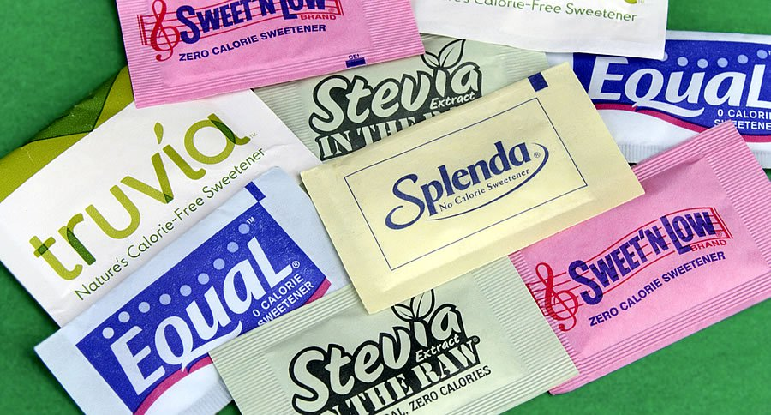
Benefits of Artificial Sweeteners
They can be helpful in weight management by reducing overall calorie consumption.
Artificial sweeteners do not spike blood sugar levels, making them suitable for diabetics.
They allow people to enjoy sweet flavors without the negative effects of sugar.
3
Notes:
Image source: https://nutritionalimmunology.org

Slide 5
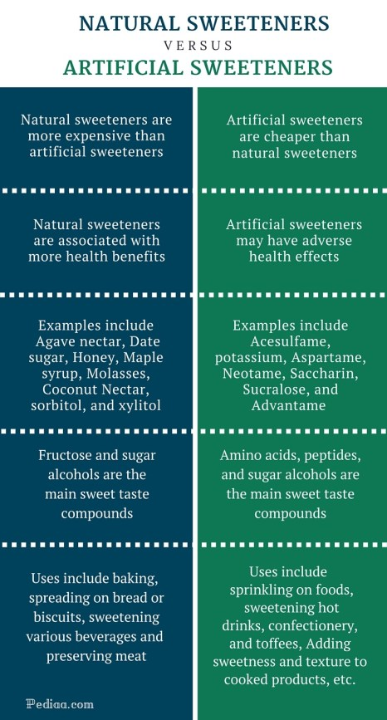
Concerns and Controversies
Some studies suggest potential links between artificial sweeteners and health issues, including metabolic disorders.
Ongoing debates exist regarding their long-term safety and effects on gut microbiota.
Regulatory agencies like the FDA have deemed many artificial sweeteners safe for consumption.
4
Notes:
Image source: https://i0.wp.com

Slide 6
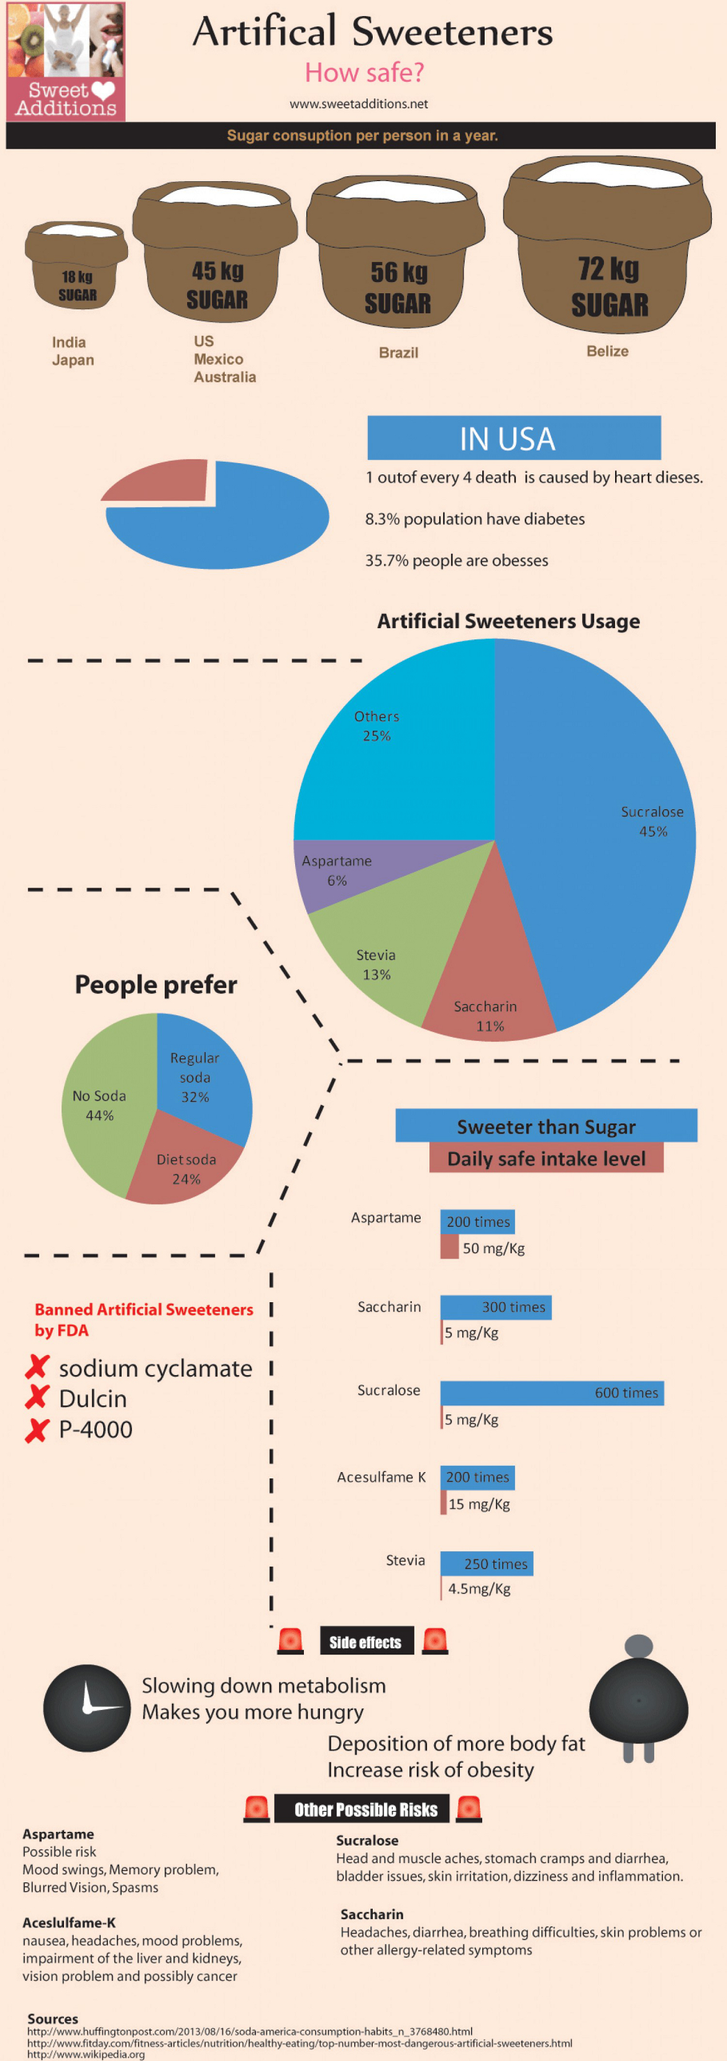
Health Impacts
Research continues to explore the connection between artificial sweeteners and appetite regulation.
Some individuals may experience adverse reactions to certain sweeteners, such as headaches or digestive issues.
The impact of artificial sweeteners on overall health remains an area of active investigation.
5
Notes:
Image source: https://healthresearchfunding.org

Slide 7
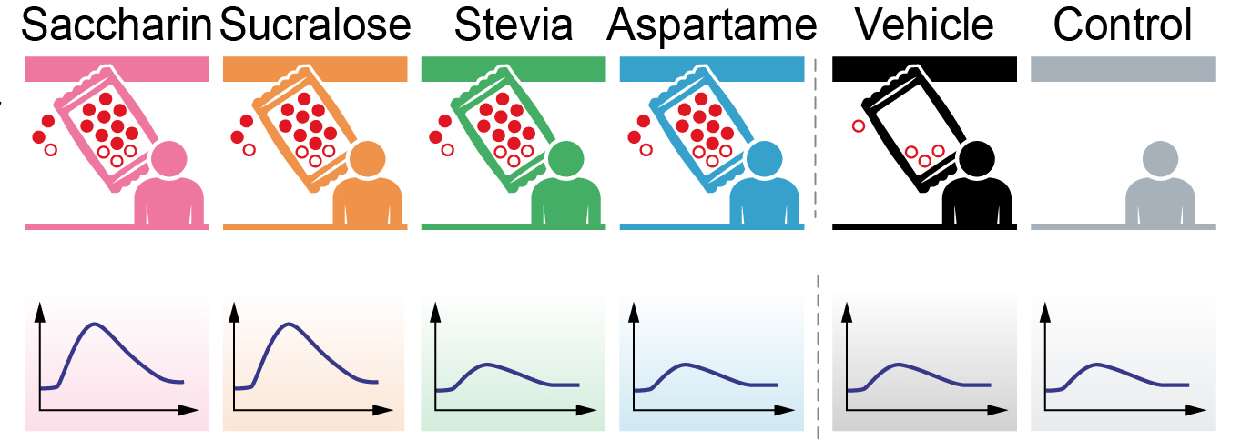
Regulatory Oversight
The FDA and other organizations evaluate the safety of artificial sweeteners before they are marketed.
Each sweetener undergoes rigorous testing to assess its health effects and acceptable daily intake levels.
Periodic reviews are conducted to ensure continued safety based on emerging research.
6
Notes:
Image source: https://healthpolicy-watch.news

Slide 8
Popular Uses in Food and Beverages
Artificial sweeteners are commonly found in diet sodas, sugar-free candies, and baked goods.
They are also used in many products labeled as "low-calorie" or "sugar-free."
Their versatility makes them popular in both commercial food production and home cooking.
7
Notes:
Image source: https://www.researchgate.net

Slide 9
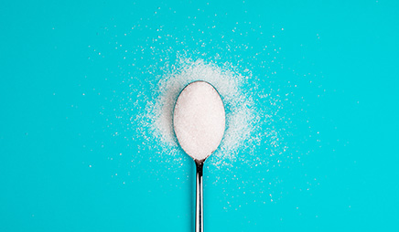
Consumer Perception and Trends
Public perception of artificial sweeteners varies, with some consumers embracing them and others expressing skepticism.
Trends indicate a growing interest in natural sweeteners, which may impact the future use of artificial options.
Education on the benefits and risks of artificial sweeteners is crucial for consumer decision-making.
8
Notes:
Image source: https://zyduswellnessinstitute.com

Slide 10
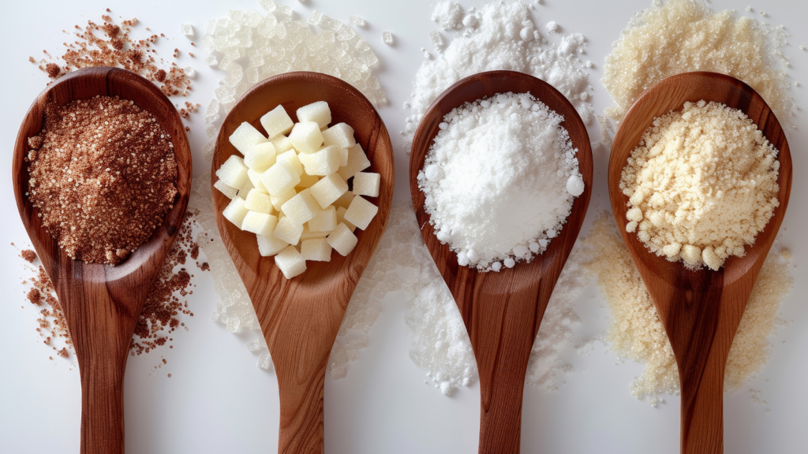
Future of Artificial Sweeteners
Ongoing research aims to develop new sweeteners that are both effective and safe for consumption.
Innovations in food technology may lead to improved formulations that mimic sugar more closely.
The market for artificial sweeteners will likely continue evolving alongside consumer preferences.
9
Notes:
Image source: https://hspop.uw.edu

Slide 11
Conclusion
Artificial sweeteners offer a way to enjoy sweetness with fewer calories, but they are not without controversy.
It is essential for consumers to weigh the benefits against potential risks when incorporating them into their diets.
Ongoing research and informed choices will shape the role of artificial sweeteners in nutrition.
10
Notes:
Image source: https://www.researchgate.net

Slide 12
References
American Diabetes Association. (2023). Artificial Sweeteners: What You Need to Know.
Food and Drug Administration. (2023). Overview of Food Ingredients, Additives & Colors.
National Institutes of Health. (2023). Artificial Sweeteners and Health: A Review of Current Literature.
Feel free to modify or expand on any of the slides as needed!
11

